Slide 1
Selenium Basics
Rama Teja Meduri
ArunKumar Jayachandran

Slide 2
What IS SELENIUM
SELENIUM is a free (open-source) automated testing framework used to validate web applications across different browsers and platforms
Languages Supported:
Java
C#(.Net)
Python
Perl
PHP
Ruby etc..

Slide 3
EVOLUTION OF SELENIUM
Jason Huggins
Developed JavaScriptTestRunner and renamed as Selenium Core
Issue: Same Origin Policy (Request must be same domain. Domain includes protocol, hostname and Port number)
Paul Hammant
Developed Selenium RC inducing HTTP proxy to selenium server.
Simon Stewart
Developed Web Driver first cross-platform testing framework that could control the browser from the OS level.

Slide 4
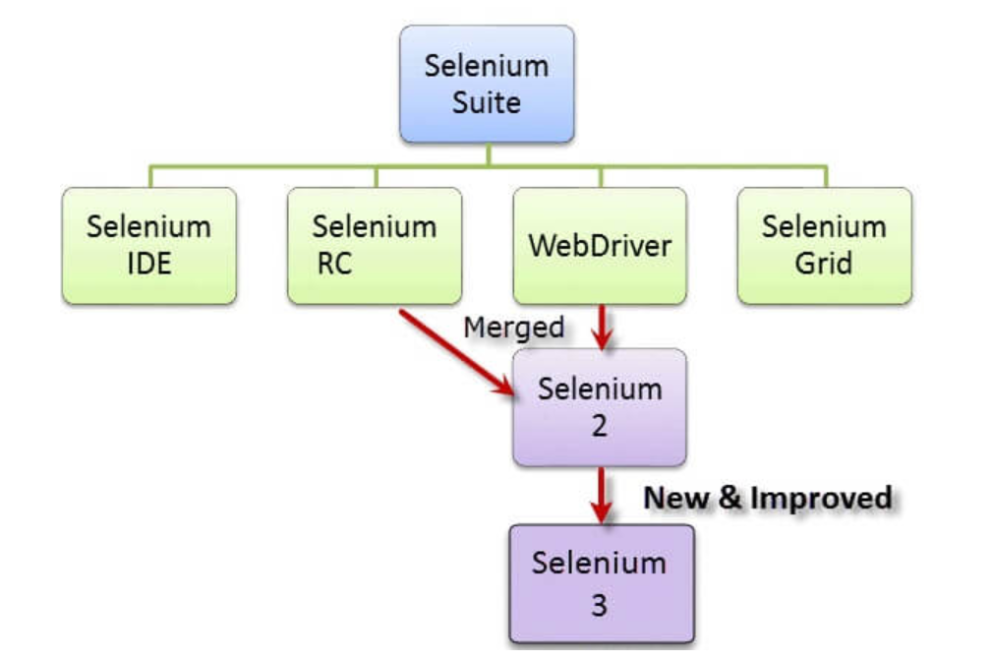
Selenium Components

Slide 5
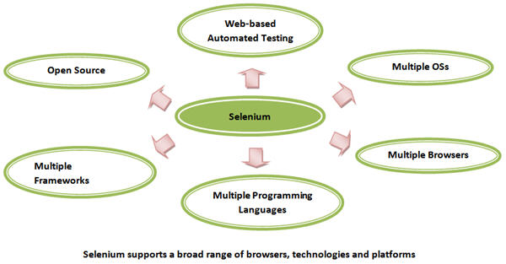
Selenium WebDriver

Slide 6
SELENIUM INSTALLATION
Quick walk through:
https://www.guru99.com/installing-selenium-webdriver.html
Chrome Driver.exe:
https://chromedriver.chromium.org/downloads
Firefox(Gecko Driver.exe):
https://www.guru99.com/installing-selenium-webdriver.html

Slide 7
1) Initializing the WebDriver
1) Firefox -
System.setProperty(“webdriver.gecko.driver”, “<driver path>\geckoDriver.exe”);
WebDriver driver=new FirefoxDriver();
2) Chrome -
System.setProperty(“webdriver.chrome.driver”, “<driver path>\chromeDriver.exe”);
WebDriver driver=new ChromeDriver();
3) IE -
System.setProperty(“webdriver.ie.driver”, “<driver path>\IEDriverServer.exe”);
WebDriver driver=new InternetExplorerDriver();

Slide 8
2) Open browser window
driver.get(“http://www.google.com”);
driver.manage().window().maximize();
driver.getTitle();
driver. getPageSource();
driver.getCurrentUrl();

Slide 9
3) Locating the Web Elements
By Id
By className
By name
By xpath
By css selector
By linkText
By partialLinkText
By tagName
Eg. driver.findElement(By.id(“login_button”));

Slide 10
4) Perform Operations on Simple WebElements
click()
sendKeys()
submit()
clear()
getText()
getAttribute(“value”)

Slide 11
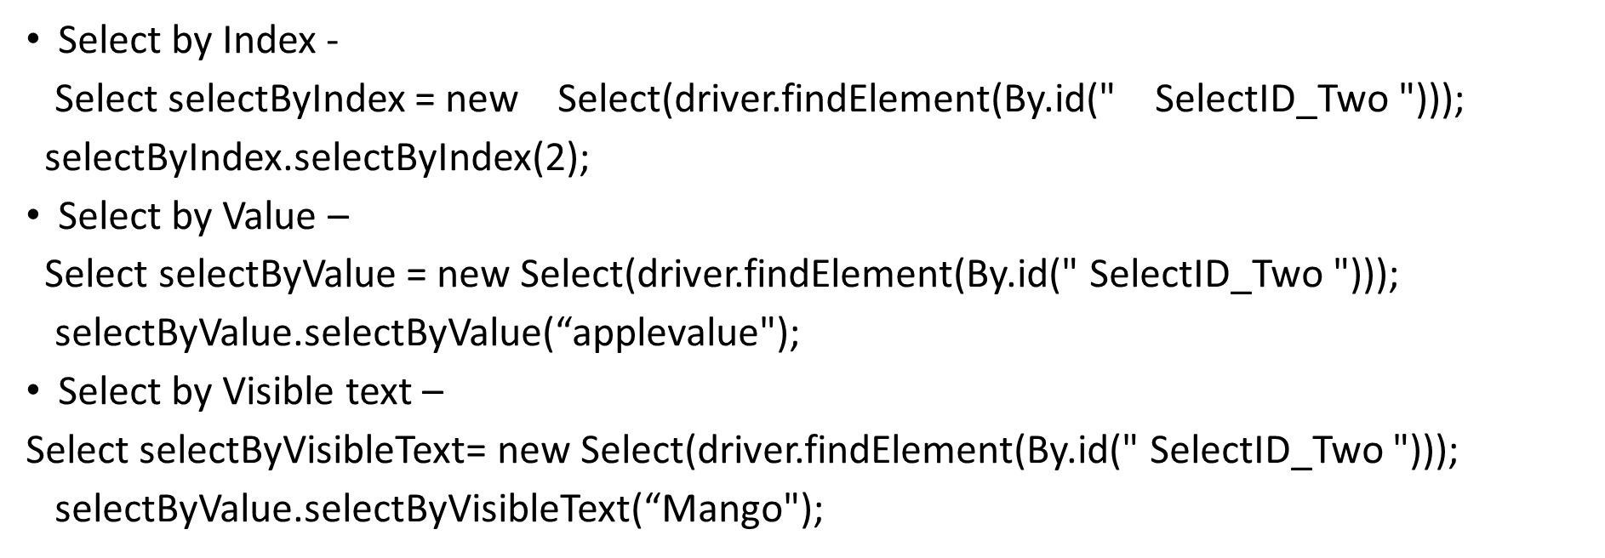
5)DROPDOWN WEB ELEMENT
<select id="SelectID_Two">
<option value="applevalue">Apple</option>
<option value="orangevalue">Orange</option>
<option value="mangovalue">Mango</option>
<option value="limevalue">Lime</option>
</select>

Slide 12
6)ALERTS
- Web Based Popups
driver.switchTo().alert().dismiss() – The dismiss() method clicks on the “Cancel” button as soon as the pop up window appears.
driver.switchTo().alert().accept() – The accept() method clicks on the “Ok” button as soon as the pop up window appears.
driver.switchTo().alert().getText() – The getText() method returns the text displayed on the alert box.
driver.switchTo().alert().sendKeys(“Text”) – The sendKeys() method enters the specified string pattern into the alert box.

Slide 13
7)HANDLING MULTIPLE WINDOWS
i)String handle= driver.getWindowHandle();//Return a string of alphanumeric window handle
ii) Set<String> handle= driver.getWindowHandles();//Return a set of window handle
iii) driver.switchTo().window("windowName");
iv) for (String handle : driver.getWindowHandles()) {
driver.switchTo().window(handle);

Slide 14
8) Implicit and Explicit Waits
Implicit Wait –
An implicit wait tells WebDriver to poll the DOM for a certain amount of time when trying to find an element or elements if they are not immediately available
The implicit wait is set for the life of the WebDriver object instance.
drv.manage().timeouts().implicitlyWait(10, TimeUnit.SECONDS);
Explicit Wait –
Explicit waits are used to halt the execution till the time a particular condition is met or the maximum time has elapsed
Unlike Implicit waits, Explicit waits are applied for a particular instance only.
WebDriverWait wait = new WebDriverWait(drv,30);
wait.until(ExpectedConditions.visibilityOfElementLocated(By.xpath("//div[contains(text(),'COMPOSE')]")));

Slide 15
9) Actions Class – Handling keyboard and mouse events
doubleClick() - Performs a double-click at the current mouse location.
clickAndHold() - Clicks (without releasing) at the current mouse location.
dragAndDrop(source, target) - Performs click-and-hold at the location of the source element, moves to the location of the target element, then releases the mouse.
keyDown(modifier_key) - Performs a modifier key press. Does not release the modifier key - subsequent interactions may assume it's kept pressed.

Slide 16
keyUp(modifier _key) - Performs a key release.
moveToElement(toElement) - Moves the mouse to the middle of the element.
release() - Releases the depressed left mouse button at the current mouse location
Actions builder = new Actions(driver);
Action mouseOverHome = builder .moveToElement(link_Home) .build();
mouseOverHome.perform();

Slide 17
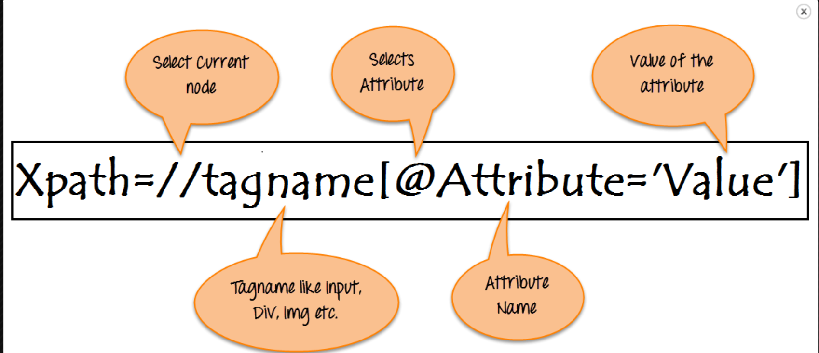
10) xpath
Absolute xpath - Uses Complete path from the Root Element to the desire element.
/html/body/div[2]/div[1]/div[1]/a
Relative xpath = the path starts from the middle of the HTML DOM structure
//div[class="qa-logo"]/a
Contains()
driver.findElement(By.xpath(“//*[contains(@id,’username’)]”)).sendKeys(“username”);
Starts-with()
driver.findElement(By.xpath(“//*[starts-with(@id,’user’)]”)).sendKeys(“username”);

Slide 18
11) Other commonly used commands
isSelected()
isEnabled()
Navigate.to()
Navigate.back()
navigate.forward()
navigate.refresh()

Slide 19
12) Close the browser
driver.close() : It closes only the browser window that WebDriver is currently controlling
driver.quit() : It closes all windows that WebDriver has opened

Slide 20
References
https://www.softwaretestinghelp.com/selenium-tutorial-1/
http://www.seleniumeasy.com/selenium-webdriver-tutorials
http://seleniumworks.blogspot.com/ -> CSS selector reference
https://www.guru99.com/xpath-selenium.html -> XPATH selector reference

Slide 21
package selenium;
import org.openqa.selenium.By;
import org.openqa.selenium.WebDriver;
import org.openqa.selenium.chrome.ChromeDriver;
public class Startup {
public static void main(String[] args) throws InterruptedException {
System.setProperty("webdriver.chrome.driver", "C:\\Users\\rmedur910\\Downloads\\Softwares\\chromedriver_win32\\chromedriver.exe");
WebDriver driver = new ChromeDriver();
driver.get("https://www.python.org");
driver.manage().window().maximize();
System.out.println(driver.getTitle());
System.out.println(driver.getCurrentUrl());
Thread.sleep(2000);
//By.id
driver.findElement(By.id("id-search-field")).sendKeys("by.id");
Thread.sleep(3000);
driver.findElement(By.id("id-search-field")).clear();
//By.name
driver.findElement(By.name("q")).sendKeys("by.name");
Thread.sleep(3000);
driver.findElement(By.name("q")).clear();

Slide 22
//By.class
driver.findElement(By.className("search-field")).sendKeys("by.class");
Thread.sleep(3000);
driver.findElement(By.className("search-field")).clear();
//By.css.class
driver.findElement(By.cssSelector(".search-field")).sendKeys("by.css.class");
Thread.sleep(3000);
driver.findElement(By.className("search-field")).clear();
//By.css.id
driver.findElement(By.cssSelector("#id-search-field")).sendKeys("by.css.id");
Thread.sleep(3000);
driver.findElement(By.className("search-field")).clear();
//By.xpath
//*[@id="id-search-field"]
driver.findElement(By.xpath("//*[@id=\"id-search-field\"]")).sendKeys("by.xpath");
Thread.sleep(3000);
driver.findElement(By.className("search-field")).clear();
//By.link text
driver.findElement(By.linkText("Donate")).click();
driver.navigate().back();

Slide 23
//By.partial link text
driver.findElement(By.partialLinkText("Dona")).click();
driver.navigate().back();
//By.tagname
driver.findElement(By.tagName("button")).click();
//.gettext
System.out.println(driver.findElement(By.tagName("button")).getText());
//.getAttribute("className)
System.out.println(driver.findElement(By.tagName("button")).getAttribute("class"));
Thread.sleep(2000);
driver.close();
}
}

Slide 24
package selenium;
import org.openqa.selenium.By;
import org.openqa.selenium.WebDriver;
import org.openqa.selenium.WebElement;
import org.openqa.selenium.chrome.ChromeDriver;
import org.openqa.selenium.firefox.FirefoxDriver;
import org.openqa.selenium.interactions.Action;
import org.openqa.selenium.interactions.Actions;
import org.openqa.selenium.support.ui.Select;
public class Elements {
public static void main(String[] args) throws InterruptedException {
/*System.setProperty("webdriver.chrome.driver", "C:\\Users\\rmedur910\\Downloads\\Softwares\\chromedriver_win32\\chromedriver.exe");
WebDriver driver = new ChromeDriver();*/
System.setProperty("webdriver.gecko.driver","C:\\Users\\rmedur910\\Downloads\\Softwares\\geckodriver-v0.27.0-win64\\geckodriver.exe");
WebDriver driver = new FirefoxDriver();
driver.get("https://www.testandquiz.com/selenium/testing.html");
driver.manage().window().maximize();
//Radio button
driver.findElement(By.id("male")).click();
Thread.sleep(2000);
driver.findElement(By.id("female")).click();
Thread.sleep(2000);

Slide 25
// check box
driver.findElement(By.className("Automation")).click();
Thread.sleep(2000);
driver.findElement(By.className("Performance")).click();
Thread.sleep(2000);
driver.findElement(By.className("Automation")).click();
Thread.sleep(2000);
//Drop downs
Select drpdn = new Select(driver.findElement(By.id("testingDropdown")));
drpdn.selectByIndex(1);
Thread.sleep(2000);
drpdn.selectByValue("Manual");
Thread.sleep(2000);
drpdn.selectByVisibleText("Database Testing");
Thread.sleep(2000);
//Alerts and double click
Actions builder = new Actions(driver);
Action doubleClick = builder.doubleClick(driver.findElement(By.id("dblClkBtn"))).build();
doubleClick.perform();
Thread.sleep(2000);
driver.switchTo().alert().accept();
Thread.sleep(2000);

Slide 26
driver.findElement(By.xpath("/html/body/div/div[12]/div/p[1]/button")).click();
Thread.sleep(2000);
System.out.println(driver.switchTo().alert().getText());
driver.switchTo().alert().dismiss();
System.out.println(driver.findElement(By.id("demo")).getText());
Thread.sleep(2000);
driver.close();
}
}
//Drag and Drop
System.setProperty("webdriver.gecko.driver","C:\\Users\\rmedur910\\Downloads\\Softwares\\geckodriver-v0.27.0-win64\\geckodriver.exe");
WebDriver driver = new FirefoxDriver();
driver.get("https://demoqa.com/droppable/");
driver.manage().window().maximize();
driver.manage().timeouts().implicitlyWait(10000, TimeUnit.MILLISECONDS);
Actions builder = new Actions(driver);
driver.get("https://demoqa.com/droppable/");
builder.dragAndDrop(driver.findElement(By.id("draggable")), driver.findElement(By.id("droppable"))).perform();

